Slide 1
Ameren Illinois
Energy Efficiency Program
Summer Internship Webinar #1
Understanding Your Customer
Notes:
Today’s webinar is about understanding your customers and providing positive customer service experiences. A lot of you are in direct customer service roles and some of us may work behind the scenes a bit more, but we all play a role in providing exceptional customer service.

Slide 2
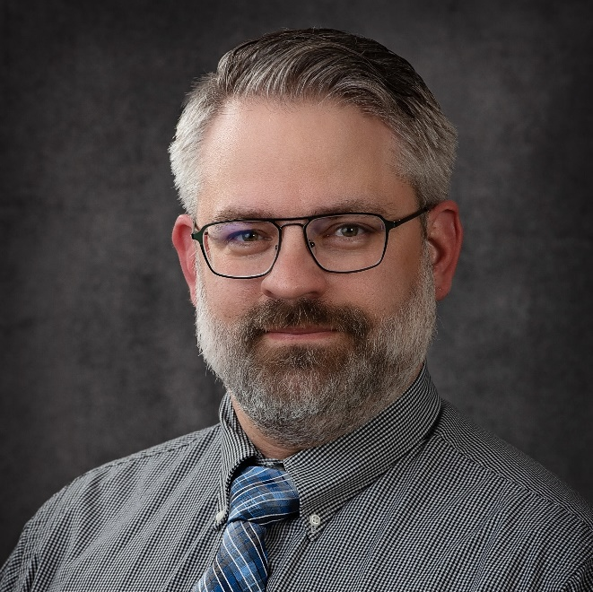
Meet Energy Professionals
Tim Dickison
Ameren Illinois Energy Efficiency Program
Program Supervisor

Slide 3
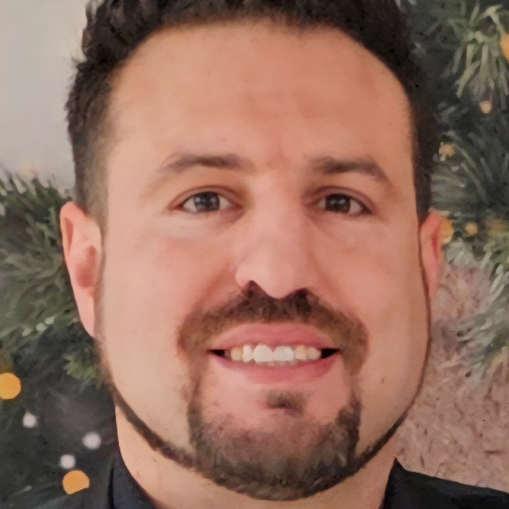

Meet Energy Professionals
Will Wuertz
Ameren Illinois Energy Efficiency Program
Lead Customer Service Representative

Slide 5

Meet Energy Professionals
Chad Whitehead
GDS Associates, Inc.
Senior Project Manager
Ameren Illinois Energy Efficiency Program Energy Advisor

Slide 6
Discussion
What types of Ameren Illinois customer interactions do you think you will have this summer?
What could make your experience with customer service positive or negative?
Talk about some general experiences you’ve had with customer service, positive or negative.

Slide 7
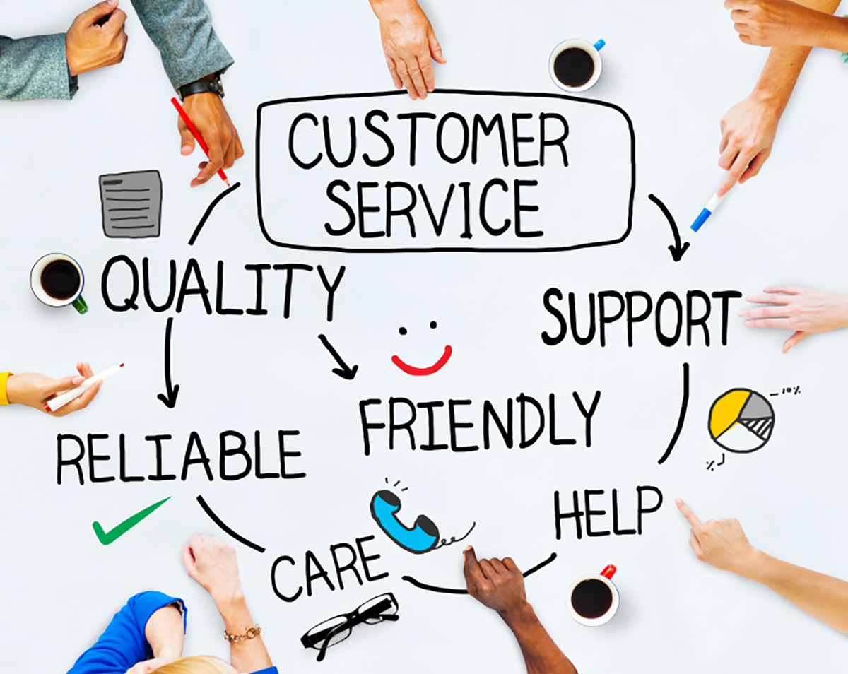
Notes:
Customer service is not a department, it is everyone's job. Customer service is really a bit of everything. You need to support and listen to the customers. Be reliable and friendly. We can show our customers a high quality of customer service when we act in these ways.
This Photo by Unknown Author is licensed under CC BY-SA-NC

Slide 8
Providing Quality
Customer Service
Notes:
The Ameren Illinois Energy Efficiency Program was developed in 2008 to encourage action through education, and to provide financial incentives to offset the cost of energy-saving upgrades. The Program helps Illinois residents and businesses save money on energy while living comfortable, safe lives.
Helps customers:
Improve Comfort
Manage Usage
Reduce Costs

Slide 9
Active Listening
Use a customer’s name.
Exhibit empathy.
Improve mutual understanding.
Maintain positivity.
Stay focused and avoid distractions.
Notes:
The key to customer service is good listening.
Active listening is a way of listening and responding to another person that improves mutual understanding. You can add some empathy and hear out your customer and call them by their name! Everyone has different motivations for choosing to be energy efficient. By being an active listener, you can help a customer build a solid foundation of understanding and choose to be energy efficient.
(Source: usip.org/public-education-new/what-active-listening, accessed June 2024))
It is important to have listening ears so you can understand your customer. Active listening is a way of listening and responding to another person that improves mutual understanding. It is an important first step to defuse the situation and seek solutions to problems. We can’t assume someone is having a good day or a bad day, but we can always try to show empathy no matter how a person is feeling.
A good tip is to write down what the customer tells you when the conversation starts. They will likely include their name and issue within the first few minutes.
Summarizing the conversation for the customer ensures you did not miss any details.
Staying focused, avoiding distractions and asking questions are some ways you can provide a positive customer service experience.
Many customers that call upset or angry are not angry with you specifically. Do not take that to heart.
Stay positive even if the customer is having a bad day. It is important that the customer feels heard.
Listening the first time will prevent the customer from having to repeat themselves.
Once the customer has finished stating their reason for calling, summarize it back to them.
Stay positive, even when it is difficult.

Slide 10
Delivering Excellent
Customer Service
Can enhance the company reputation.
Improves service delivery.
Builds trust with the customer.
Makes your job more enjoyable.
Notes:
Delivering excellent customer service has allowed the Ameren Illinois Energy Efficiency Program to save customers over $10 million in combined energy savings. It has allowed customers to understand energy efficiency, to learn about new products available that will help them save energy and money, and to make efficiency investments to their home or business in an organized timeline.
When you provide good customer service you can further your career!

Slide 11
Increasing Customer Interactions
Proactive and regular engagement with customers is possible in multiple ways.
  Customized home energy reports.
  Personalized energy bill tracking.
  Real-time energy usage.
Notes:
Customer service is also being addressed when new technologies and online tools are provided to utility customers. amerenillinoissavings.com/residential/energy-savings-center-tips-tools/

Slide 12
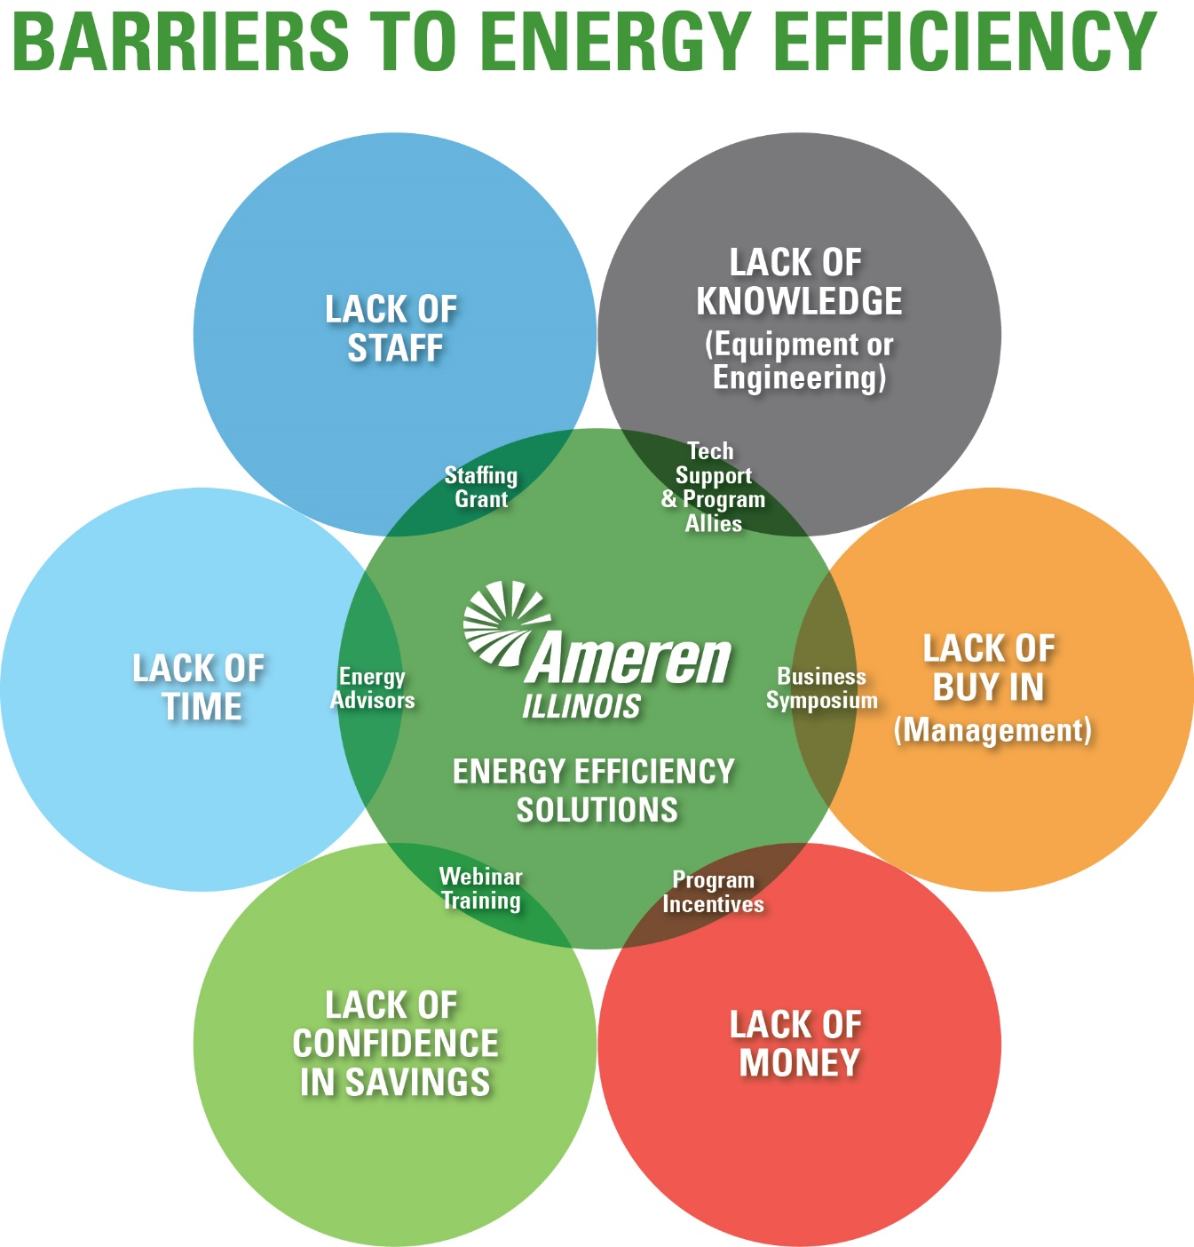
Eliminating Barriers to Energy Efficiency
Notes:
Providing customer service to a utility paying customer can help eliminate the perceived barriers to energy efficiency. Offering knowledge through webinars, marketing of program incentive programs, technology support and more can help customers feel more comfortable buying into an energy efficiency program.
There are six typical barriers to energy efficiency,:
Lack of knowledge typically of products
Lack of buy in, let’s say from the homeowner, landlord or business management
Lack of money
Lack of confidence in savings
Lack of time
Lack of staff
Your customers may have some of these barriers, all of them or just one. The key thing about these barriers and the key to building a relationship with your customer, is that the Ameren Illinois Energy Efficiency Program has a solution to or can address each one of these barriers through the work that we do.

Slide 13
Ask The Question, Do The Math
Ask the questions
  Where does energy efficiency start?
  What does that mean to me?
  How do I get there?
Do the math
  How many?
  How much?

Slide 14
Building a Relationship with
Energy Efficiency
Why should you choose energy efficiency?
What is the value of energy efficiency?
How do we become energy-efficient?
Notes:
Once the barriers to becoming energy efficiency in a customer’s home or business are eliminated, the next step is for a customer to begin building their relationship with energy efficiency. We can help a customer by asking three questions:
Why become energy efficiency?
What’s the value of energy efficiency?
How do we get energy efficient?
Why become energy efficiency?
Everyone has different motivations for why they’re going to be energy efficient. One motivation may be a global impact on the environment. It could be an increase in business’ bottom line. It could also be to save money on a home or business’ utility bills. So there are various approaches and various reasons why a customer may want to choose energy efficiency
What’s the value of energy efficiency?
The value of energy efficiency is determined in many ways, and it is up to our customer!
How do we get energy efficient?
Many of you are helping customers become energy efficient whether in the field or through marketing and outreach events.

Slide 15
Professionalism in the Workplace
Be reliable and on time.
Treat others with respect.
Use a professional email address.
Practice good communication.
Dress appropriately.
Maintain a positive attitude.
Notes:
Before we wrap up our first webinar of the summer, we wanted to share a few tips to exhibit good professionalism in your place of work. Professionalism is a set of characteristics that displays your ability to be a hardworking, dependable and respectful individual while on the job.
Some of you are new to the workforce so we wanted to share a few tips
Professional email address
Dress appropriately
Be reliable and on time
Treat others with respect
Name in Microsoft Teams
Avoid speech that is not inclusive, equitable or perpetuates stereotypes

Slide 16
Coming Up!
Next Week’s Webinar:
Energy Efficiency 101
Wednesday, June 18
Time: 8:30 A.M. – 9:30 A.M.
Guest Speakers: John Carroll and Gretchen Primeau
Notes:
The Wrap up event will be on August 6 and all of you and your employers are invited! We will be asking all of you to share a presentation about your summer experience, 2-10 minutes depending on how much you have to share!

Slide 17
Coming Up!
#1 Volunteer Event:
Date: Friday June 20th, 2025
Time: 9:00 A.M.
Location: Ironwood Golf Course
1901 N Towanda Ave
Normal, IL 61761
Notes:
The Wrap up event will be on August 6 and all of you and your employers are invited! We will be asking all of you to share a presentation about your summer experience, 2-10 minutes depending on how much you have to share!

Slide 18
Questions?

